Slide 1
Sprint 1 Review
ESMS
Jacob Holz, Gilbert Livan, Parker Steach, Landon Moon, Nam Huynh

Slide 2
Sprint Goal
Finish our Project Charter and familiarize ourselves with the tools we will use to create the application.

Slide 3
Product Backlog Items
Backlog Item | Estimate | Actual
Write the Project Charter | 42 Hours | 55 Hours
Start Learning React Native | 60 Hours | 6 Hours*

Slide 4
Sprint Burn Down Chart
We were able to make steady progress over time.
On the 22nd, we decided to finish up so that the weekend could be free of stress.

Slide 5
What did we do?
We meet in the senior design lab.
We meet with our sponsor on problems that arose.
We all created the project charter.
Research was done over the project.
We found that IOS devices prohibit SMS read permissions.

Slide 6
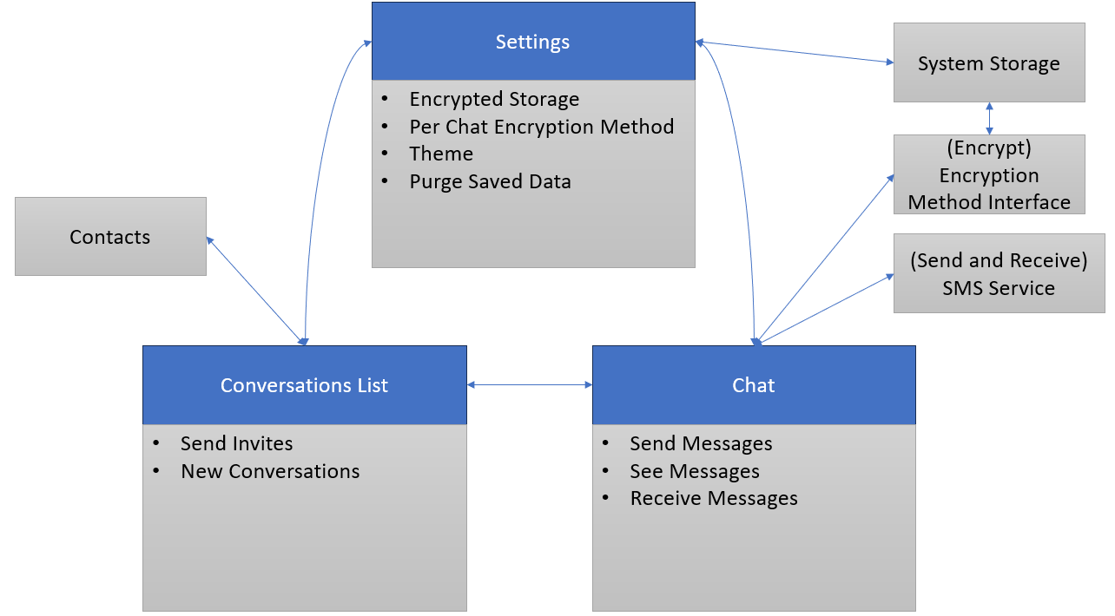
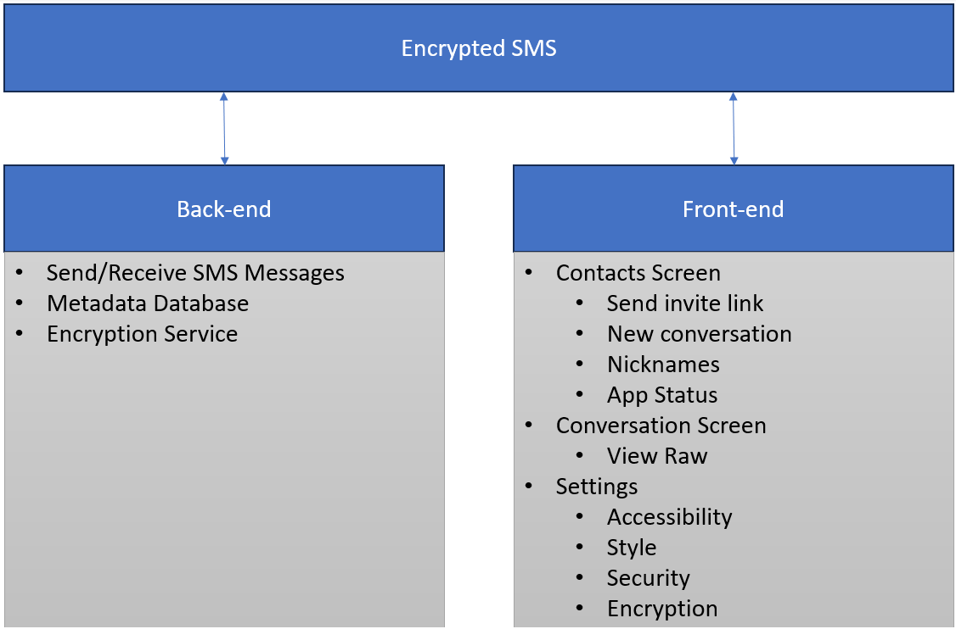
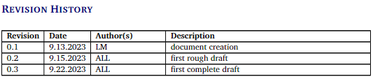
Something to show

Slide 7
Things we need
We no longer need an apple developer license or apple products

Slide 8
Questions?

Slide 9
Sprint Backlog for Item 1
Backlog Item | Estimate | Actual
Learn basic LaTeX | 10 Hours | 4 Hours
Create shared document with general formatting | 2 Hours | 1 Hour
Meet with team to finalize details and decisions about team project | 20 Hours | 15 Hours
Complete documentation and tables | 10 Hours | 35 Hours

Slide 10
Sprint Backlog for Item 2
Backlog Item | Estimate | Actual
Setup React Native environment | 10 Hours | N/A
Familiarize ourselves with the framework | 35 Hours | N/A
Investigate Expo for SMS | 10 Hours | 2 Hours*
Investigate cryptography library | 5 Hours | 1 Hour
Deciding how to move forward | New | 3 Hours
* During this step, Jacob discovered that 3rd party SMS applications were not allowed on iOS devices.

